Slide 1



Vishwakarma Application ID

Slide 2
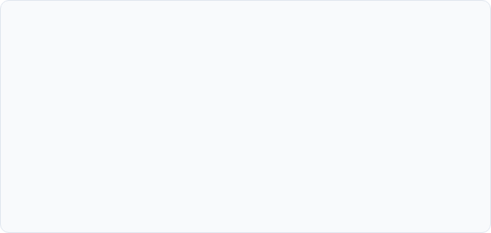

Problem Context (1-2 Slides)
Slide 1 & 2 Template
Project Overview: Title, Team ID, Track, and 1-line Core Innovation Summary.
Problem Statement: Clear, concise definition of the operational pain point and exact target beneficiary segment.

Slide 3
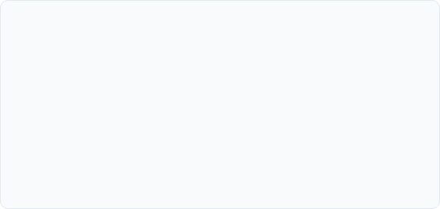

User Journey (1-2 Slides)
Visual "Before State" Requirement
Visual "After State" Requirement
Current Pain Point Mapping: Include a clear flowchart, storyboard, or diagram illustrating current issues faced by the users due to lack of the solution proposed by you.
Future Solution Mapping: Include a clear flowchart, storyboard, or diagram illustrating how your solution will benefit the users.
Quantified Efficiency: Benchmark time gain, material usage, labor cost, or safety post your innovation.
Quantified Inefficiency: Benchmark time loss, material waste, labor cost, or safety hazards prior to innovation.

Slide 4






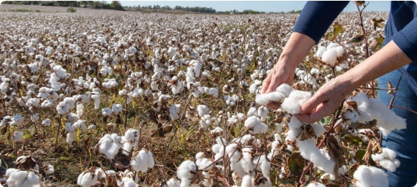
Example: Problem Context & User Journey
₹4,200/Ac
62 Hrs/Ac
28% Loss
68 dB(A)
MANUAL WEEDING EXPENSE
MANUAL LABOR TIME
YIELD LOSS VIA WEED STUNT
SAFETY EXPOSURE LIMIT
Target Beneficiary & Before-State User Flow
▪
Target User: Smallholder cotton farmers in Vidarbha, Maharashtra operating 1–4 acre farms with 45cm crop row spacing.
▪
Operational Bottleneck: Severe seasonal labor shortages during the 20-day weed-competition window force reliance on manual sickle scraping or drift-heavy herbicides.
▪
Before-State Flow: Weed infestation emerges (Day 1-5) → 72-hr delay finding scarce farm labor → Slow manual hoeing (0.15 ac/day) causing back strain → Late glyphosate spraying damages 14% cotton plants.
▪
Public Search Disclosure: Commercial weeding tractors require >30 HP and >1.2m row spacing, crushing crops. Hand-carried weeders cause severe musculoskeletal fatigue after 3 hrs.
Figure: Vidarbha smallholder inspecting severe weed infestation along 45cm cotton rows
Exemplar Submission Note: Team ID: VK-2026-AG-108 | Track: Smart Agriculture & Mechanization | Core Innovation: Compact autonomous active-tine row weeder.

Slide 5

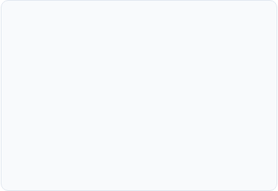
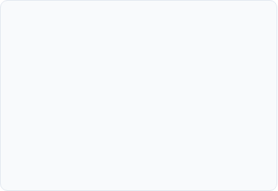



System Architecture & Specs (1-2 Slides)
System Block Diagram
Target Specifications
Hardware Selection
Map out integrated subsystems: Mechanical Structure, Actuation/Power, Electronic Controllers, and Firmware/Logic flow.
List key operational targets (e.g., Payload capacity: 25kg, Operating speed: 1.5m/s, Battery backup: 4 hrs, Power draw: 200W).
Specify exact microcontroller, motor driver, sensor types, and communication protocols chosen for the architecture.

Slide 6
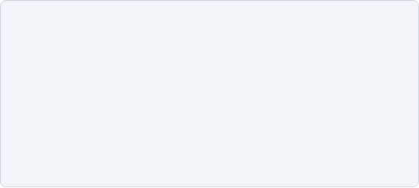


Example: System Architecture & Specs
Engineering Target Specifications & Subsystems
Parameter | Target Spec | Selected Hardware / Protocol
Linear Speed | 0.8 m/s (2.88 km/h) | 4x 24V 150W Planetary BLDC Hub Motors
Weeding Width | 420 mm envelope | Counter-rotating carbide tine disc assembly
Continuous Runtime | 4.5 Hours | 24V 20Ah LiFePO4 pack (8S 32700 cells)
Core Controller | 50Hz control loop | STM32F405RGT6 (CAN-bus isolated transceiver)
Vision & Row Tracking | <35ms latency | Raspberry Pi Zero 2W + Sony IMX219 (IP65 lens)
Dry Weight | 24.5 kg | 6061-T6 Extruded Aluminum space-frame
Figure: TerraWeed Mk-II modular 4-wheel rover platform with articulated steering
Architecture Rationale: CAN-bus protocol was chosen over I2C/UART to eliminate high-frequency EMI noise generated by dual rotary tine motors under heavy torque loads.

Slide 7

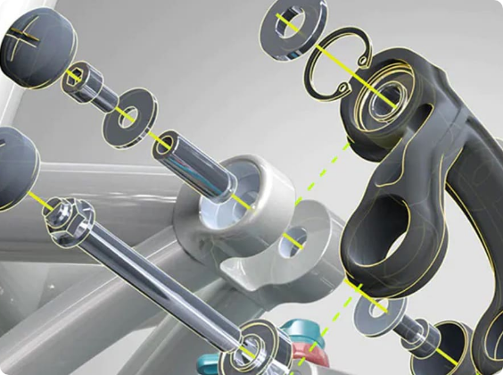
CAD Design & Mechanical Specs (1-2 Slides)
3D CAD Renders: Provide isometric and exploded assembly views showing all internal mechanical linkages.
Material Selection: Detail structural choices (e.g., Aluminum 6061 vs. Carbon Fiber vs. PETG) based on stress & weight.
FEA / Stress Analysis: Highlight critical stress nodes and load-bearing calculations to prove hardware integrity.

Slide 8

Example: CAD Design & Mechanical Specs
Mechanical Validation & FEA Stress Report
▪
Chassis Members: 30x30x2mm Aluminum 6061-T6 box extrusion; total frame mass 6.2 kg; yield strength 276 MPa.
▪
Rotary Tiller Blades: Hardened EN45 Spring Steel with oil-quenched temper (48 HRC) to withstand quartz abrasion and stone impacts.
▪
FEA Loading Simulation: 350 N dynamic shock load applied vertically to suspension pivot bracket (simulating a 50mm ditch drop at 1.0 m/s).
▪
Stress & Safety Factor: Peak Von Mises stress of 114.2 MPa concentrated at pivot fillet; minimum Factor of Safety (FoS) = 2.41.
▪
Max Deflection: 0.42 mm along cantilevered drive axis, well within deep-groove ball bearing angular misalignment tolerances.
Figure: SolidWorks exploded assembly of active rotary weeding module & 4-bar linkage
Design Iteration: Tiller mount plate thickness increased from 3.0mm to 4.5mm based on FEA fatigue analysis, eliminating stress hot spots under cyclic torque.

Slide 9

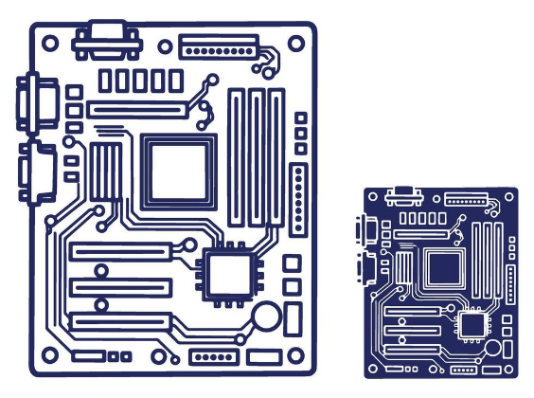
Electronics Schematics & BOM (1-2 Slides)
Circuit Schematics: Provide clear pinout connection diagrams, power distribution networks, and voltage regulation.
Itemized BOM Table: List all components, exact part numbers, quantities, unit costs, and total build expense.
Procurement Sourcing: Flag local vs. imported components with verified vendor lead times to prevent build delays.

Slide 10

Example: Electronics Schematics & BOM
Itemized Prototype Bill of Materials (BOM)
Component | Part / Specification | Qty | Lead Time | Cost (INR)
MCU Mainboard | STM32F405RGT6 Arm M4 | 1 | Local (3 days) | ₹1,450
BLDC Hub Motors | 24V 150W Planetary (1:20) | 4 | Domestic (7 days) | ₹14,200
Smart BMS Unit | Daly 8S 24V 40A UART | 1 | Local (2 days) | ₹2,100
LiFePO4 Cells | 3.2V 20Ah 32700 Cylindrical | 8 | Domestic (5 days) | ₹6,800
Ultrasonic Sensor | JSN-SR04T Waterproof (IP67) | 3 | Local (2 days) | ₹1,150
Custom Carrier PCB | FR4 2-Layer 1.6mm (LionCircuits) | 5 | Domestic (6 days) | ₹1,800
Total Electronics & Drive Train BOM | ₹27,500
Figure: Custom carrier board schematic with optocoupled BLDC drivers and buck stages
Procurement Status: All core components sourced domestically within India with a maximum shipping lead time of 7 business days.

Slide 11



Your Maker Journey (1-2 Slides)
Authenticity Verification
Work-In-Progress Software Evidence
Raw Repository Linkage
Proof of personal fabrication:
Screenshots of original design assets:
Provide an accessible Google Drive / GitHub repo link:
Include high-resolution lab photos of team members actively modeling, soldering, and assembling.
CAD software UI showing active parametric feature tree with unsuppressed sketches.
Must include raw native files (.STEP, .SLDPRT, .kicad_sch, .m).
File creation timestamps will be audited to confirm progress during Stage 2.
EDA layout software (KiCad / Altium) with DRC rule-check logs.
Team members must wear institutional ID badges in the frame.
FEA convergence plots and mesh statistics.
No embedded videos; provide external links only.
If a faculty mentor is attached, include a joint lab review photo.

Slide 12
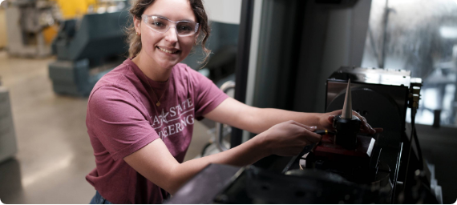
Example: Maker Journey
Stage 1 to Stage 2 Engineering Iterations
▪
Iterative Pivot: Replaced passive cultivator shank from Stage 1 with dual active counter-rotating discs after torque calculations indicated 40% soil clogging in clayey black cotton soil.
▪
CAD Milestone: 47 discrete parametric parts modeled in SolidWorks 2024; completed kinematic multi-body simulation of 4-bar steering on Aug 24, 2026.
▪
Electrical Testing: Validated current surge on 24V bus during tiller stall (peaked at 18.2A for 120ms; managed safely by flyback diodes and smart BMS cutoff).
▪
Verified Drive Repository: drive.google.com/drive/folders/terraweed-stage2-audit (Contains timestamped .SLDASM, BOM.xlsx, KiCad v8 schematics, and raw FEA stress logs).
Figure: Team members conducting motor dyno & telemetry testing at COEP Pune Maker Lab
Institutional Sign-Off: Work audited and certified by Faculty Guide Prof. S. K. Kulkarni, Dept. of Mechatronics, COEP Technological University Pune.

Slide 13


Safety & Hazard Mitigation (1 Slide)
Safety & Hazard Mitigation
Standards Compliance
Physical Fail-safes: Emergency cut-off switches, thermal overload protection, and mechanical enclosures.
List relevant industry/safety guidelines (e.g., ISO, IEEE, IP65 ingress protection) considered in the design.
FMEA Matrix: Identify potential failure modes (e.g., sensor drift, power drop) and embedded software protections.

Slide 14
Roadmap (1 Slide)
4-Month Fabrication Plan
Fabrication Timeline: Milestones for machining, PCB etching/assembly, code integration, and bench testing.
Stage 3 Target: Clear commitment of prototype readiness for functional field testing in Stage 3.

Slide 15



Example: Safety by Design & Roadmap
Design FMEA (Failure Mode and Effects Analysis)
Failure Mode | Potential Hazard | Embedded Fail-Safe / Mitigation Response
Tiller Stone Jam | BLDC motor stall, thermal runaway, gear shear | Hall-sensor current spike detection cuts PWM in <15ms; triggers 0.5s auto-reverse cycle.
Loss of RF Heartbeat | Runaway robotic vehicle in crop field | Software watchdog timer executes emergency dynamic braking if ping timeout > 350ms.
LiFePO4 Over-Temp | Thermal degradation, fire risk | Dual NTC thermistors on battery pack disconnect main BMS power contactor above 52°C.
Fabrication Phase (Months 1 - 2)
Integration & Field Demo (Months 3 - 4)
▪
Oct 2026: Waterjet cutting 6061 chassis gussets; PCB fabrication at LionCircuits; component order arrival.
▪
Dec 2026: Closed-loop PID tuning, optical row-tracking calibration on artificial soil furrow.
▪
Nov 2026: Frame weldment, motor harness routing, benchtop dyno torque testing.
▪
Jan 2027: 50-hour field trial on Wardha cotton plot; final tuning for Stage 3 live jury demo.

Slide 16

Technical Challenges & Risks (1 Slide)
Engineering Bottlenecks
Detail major design constraints encountered during simulation (e.g., torque vs. weight trade-offs, heat dissipation).

Slide 17

Potential Solutions & Risk Mitigation (1 Slide)
Risk Mitigation
Explain backup technical solutions (e.g., modular gear reduction, alternative sensor fallback logic).

Slide 18



Example: Technical Challenges & Risks
Bottleneck: Wet Soil Clogging
Bottleneck: Thermal Throttling
Standards & Enclosure Specs
Observed Risk: High-moisture (>25%) black cotton soil adheres to rotary cultivator teeth, causing rotational binding within 12 minutes of continuous furrow tilling.
Observed Risk: Hub motor temperatures reached 68°C in simulation during sustained noon operations at 38°C ambient Maharashtra field heat.
ISO 4254-1 Compliance: 2mm sheet steel blade shrouds eliminate projectile pebble hazards.
IP65 Ingress Sealing: Gasket-sealed ASA electronics bay with IP68 PG7 cable glands tested against direct pressurized spray.
Mitigation: Installed stationary low-friction PTFE scraper blades offset 1.5mm from the tine arc to dynamically peel away clay buildup on every rotation.
Mitigation: Retrofitted extruded radial aluminum heatsinks directly coupled via 3.0 W/mK silicone thermal pads, stabilizing motor casing temps below 47°C.
IEC 62133: BMS equipped with cell-level thermal sensors and overcharge isolation.
Empirical Verification: Benchtop clay test rig showed a 94% reduction in mechanical rotational drag after installing the PTFE scraper combs.

Slide 19


References & Sources
(Mention the References and Sources used in your PPT)
https://damassets.autodesk.net/content/dam/autodesk/www/images/3d-f-2.jpg
Source: www.autodesk.com
https://static.vecteezy.com/system/resources/previews/073/726/958/non_2x/schematic-motherboard-design-with-electronic-components-and-circuitry-outline-depicting-computer-hardware-technology-and-engineering-vector.jpg
Source: janetmedicalclinic.com

Slide 20






Image Sources
https://assets.farmjournal.com/dims4/default/a754738/2147483647/strip/true/crop/1640x924+0+0/resize/1440x811!/quality/90/?url=https%3A%2F%2Fk1-prod-farm-journal.s3.us-east-2.amazonaws.com%2Fbrightspot%2Fa6%2F33%2Fa69c7199437191c11311d3b6b42f%2Fcotton-before-harvest-as-382887942.jpg
Source: www.agweb.com
https://static.manitobacooperator.ca/wp-content/uploads/2021/12/08154933/IMGP6708_Rover_R-Tech.jpeg
Source: www.manitobacooperator.ca
https://cdn.cadcrowd.com/3d-models/e2/4e/e24ed1e8-571b-42b1-a15d-abf63ff0856c/gallery/3bdc439b-02cc-448e-afd2-b4615ad703f4/medium.jpg
Source: www.cadcrowd.com
https://www.protoexpress.com/wp-content/uploads/2021/12/image2-6.png
Source: www.protoexpress.com
https://docs.gato.txst.edu/775149/w/2000/bBHGqEbMKzTl/_DSC4275%201.jpg
Source: www.engineering.txst.edu

